Slide 1
Nick Shockey
DIRECTOR, RIGHT TO RESEARCH COALITION
Open Science Summit 2011
Mountain View, CA
October 23, 2011
nick@arl.org

Slide 2
Open Access (OA) is the free, immediate, unrestricted availability of high-quality, peer-reviewed scholarship over the Internet – combined with the rights to use this information to its fullest possible extent
- The Budapest Open Access Initiative, 2002

Slide 3
4 paths to Open Access:

Slide 4
X 7,000
1. Publish in an open-access journal
(the gold route)
“Open access has been at the heart of NPG’s expansion for the last two years…of the five new journals we have launched in 2011, four have been open access.”
Steven Inchcoombe
Managing Director, Nature Publishing Group

Slide 5
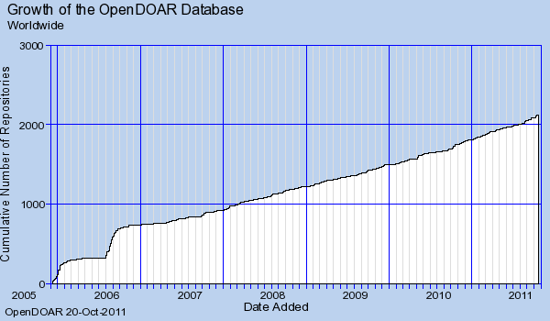
2. Publish in an open-access repository
(the green route)
X 2,000
From OpenDOAR, http://www.opendoar.org/find.php?format=charts [Accessed 10/19/11]

Slide 6
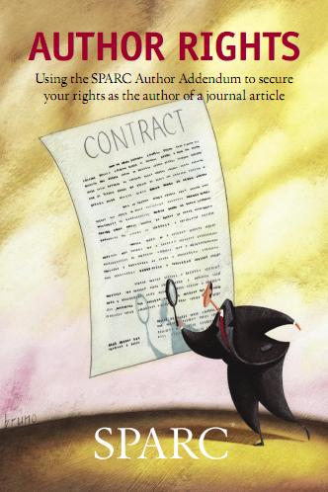
3. Effectively manage copyright
I.
III.
II.
^{www.arl.org/sparc/author}

Slide 7
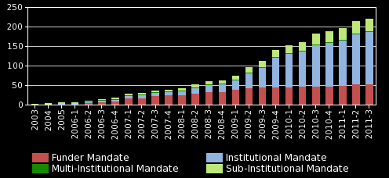
4. Policy advocacy (Institutional & Funder)

Slide 8
Institutional open-access policies
…and 122 others

Slide 9
Funder open-access policies

Slide 10
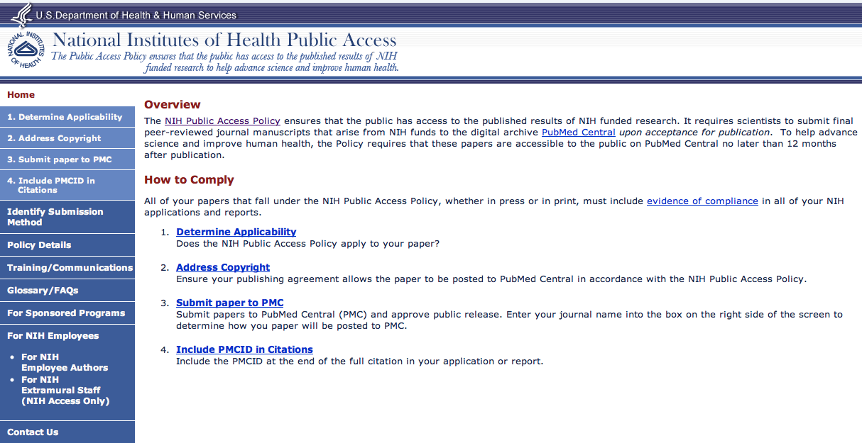
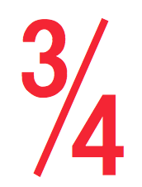
The result:
X 80,000/year
X ~500,000/day
X 2,000,000 total
from outside the Academy

Slide 11
Why is Open Access important?

Slide 12
The current system is broken

Slide 13
40% of researchers can’t access resources they need on a DAILY or WEEKLY basis (UK Study)
Source: Research Information Network, “How researchers secure access to licensed content not immediately available to them,” December 2009

Slide 14
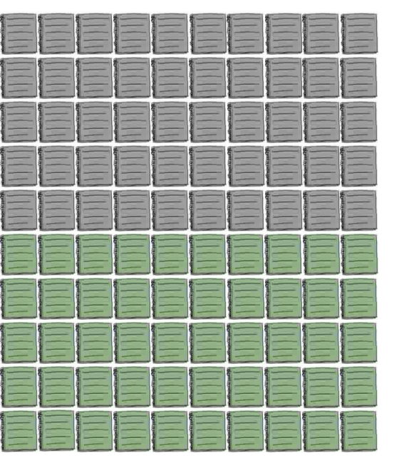
The average academic library in the UK has access to just HALF of all journals

Slide 15
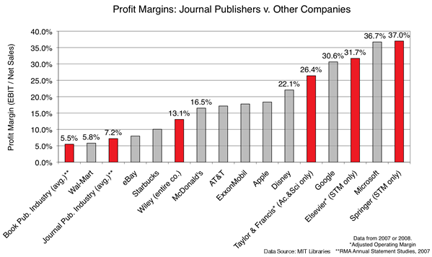
Publishing has become big business…

Slide 16
Rapidly Rising Prices…
1975-1995
200-300% > Inflation
1995-2009
7-10% per year

Slide 17
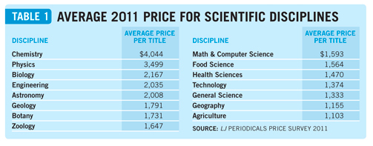
Average journal prices
Chemistry
Physics
Biology
= $4,044
= $3,499
= $2,167
Health Sciences
Engineering
Astronomy
= $2,035
= $2,008
= $1,470
Source: “Periodicals Price Survey 2011: Under Pressure, Times Are Changing,” by Stephen Bosch, Kittie Henderson, & Heather Klusendorf. Library Journal, April 14, 2011. http://www.libraryjournal.com/lj/newslettersnewsletterbucketljxpress/890009-441/periodicals_price_survey_2011_under.html.csp

Slide 18
European Commission Report: On average, for-profit journals are 3 TIMES more expensive than non-profits¹ In neuroscience, for-profit journals are 890% more expensive (per page)²
¹ Study on the economic and technical evolution of the scientific publication markets in Europe, Commissioned by the European Commission
² The Costs and Benefits of Site Licences to Academic Journals”, Proceedings of the National Academy of Sciences, C.T. Bergstrom and T.C. Bergstrom.

Slide 19
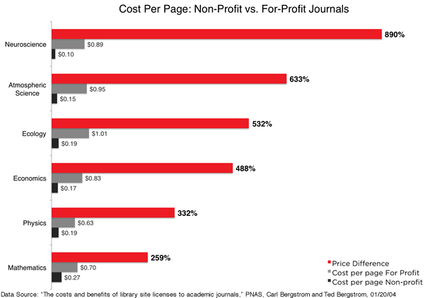

Slide 20
Tremendous advantages of an open system

Slide 21
How students are changing the system

Slide 22
Launched in Summer 2009
Built around the Student Statement on the
Right to Research: access to research is a
student right
International alliance of 40 graduate &
undergraduate student organizations,
representing nearly 7 million students in
about 100 countries around the world
Two program areas: advocacy & education
Notes:
A bit of history on our coalition:
Stage 1: Spend the first year just getting off the ground, establishing a base in North America, did that well; spent the second year going international, building a truly global network
Stage 2: Fully leverage our network to make students an even stronger force in pushing for change around Open Access; tie interested organizations, support them with resources, and essentially catalyze large-scale, meaningful action on OA

Slide 23
“…the degree of student initiative and engagement at UBC, thanks to the efforts of this student and alum, gives this issue a whole new impetus.”

Slide 24
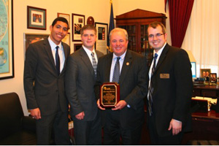

Slide 25
******************************************
Students lobbying professional societies:
Screenshot of Ivan’s JEPS article
EMSA → CPME
BMA
Emphasize the external and internal influence
External in that the student orgs are lobby from the outside
Internal in that students represent the future of each organization → organic change from within

Slide 26
AMSA works Open Access into their program annually; just came back from Global Health Symposium
CFS producing resources on their own
Tin presenting at ZIMS
Students taking the issue back to their home countries: UK, Switzerland, Greece, Catalonia, Spain, Mexico, Germany, Lebanon, Brazil, Kenya,
Students are the future. By educating today’s students, we can ensure this problem doesn’t replicate itself in the future.

Slide 27
Notes:
The future: we’re building resources and the students are putting them into use

Slide 28
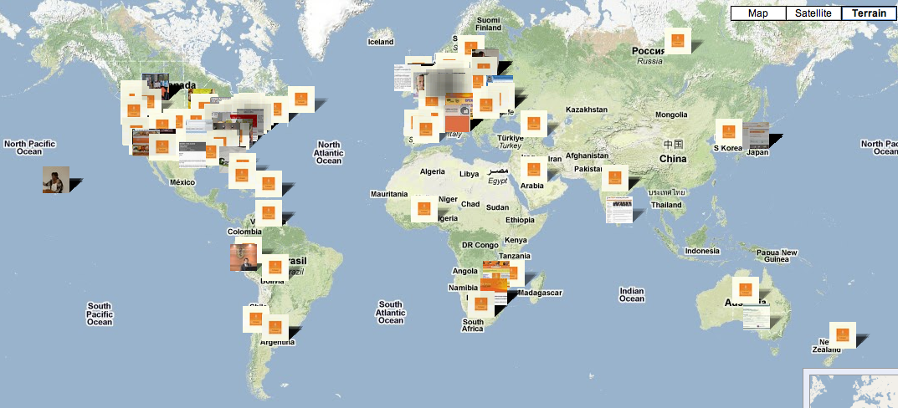
Open Access Week: October 24-30, 2011

Slide 29
2 webcasts:
The State of Open Access and the Student Role in
Creating Change
When: Monday, October 24th at 8pm EDT
Open Access and the Impact of Open on Research
When: Wednesday, October 26th at 12pm EDT

Slide 30
Thank you!
Email: nick@arl.org
Facebook: facebook.com/righttoresearch
Twitter: @r2rc
Web: www.righttoresearch.org

Slide 32
The future will be - -shaped
and built of Open Access.
Nick Shockey
DIRECTOR, RIGHT TO RESEARCH COALITION
Open Science Summit 2011
Mountain View, CA
October 23, 2011
nick@arl.org

Slide 33
Resources

Slide 35
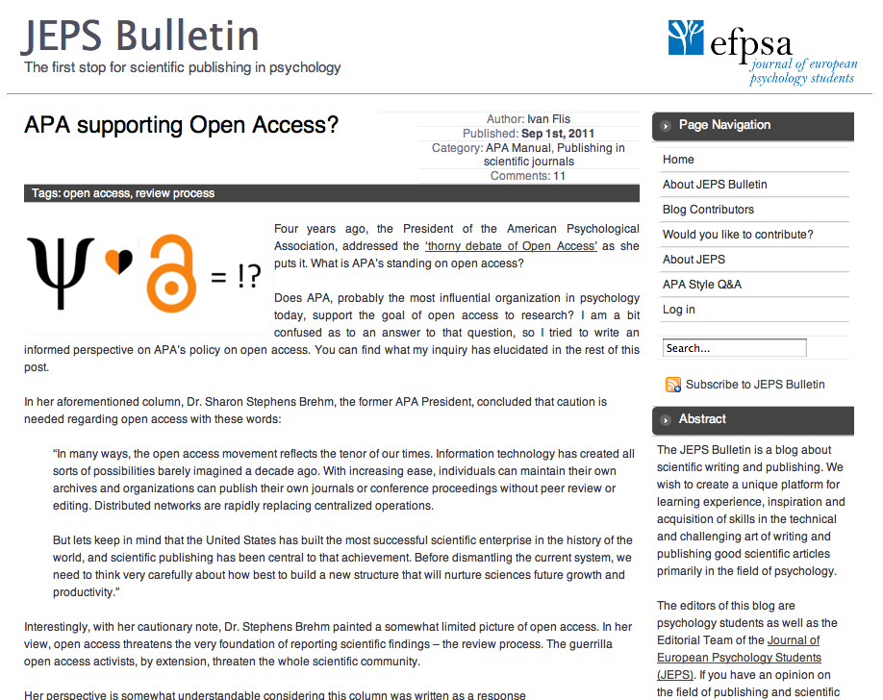
******************************************
Students lobbying professional societies:
Screenshot of Ivan’s JEPS article
EMSA → CPME
BMA
Emphasize the external and internal influence
External in that the student orgs are lobby from the outside
Internal in that students represent the future of each organization → organic change from within
“The American Psychological Association, as the leader in the world of scientific publishing in psychology, should show initiative and vision in open and staunch support of open access.”

Slide 36
Some Open Access basics
Why is Open Access important?
What are students doing to make Open Access a reality?

