Slide 1
Transition to Openness
Carlo Rago

Slide 2
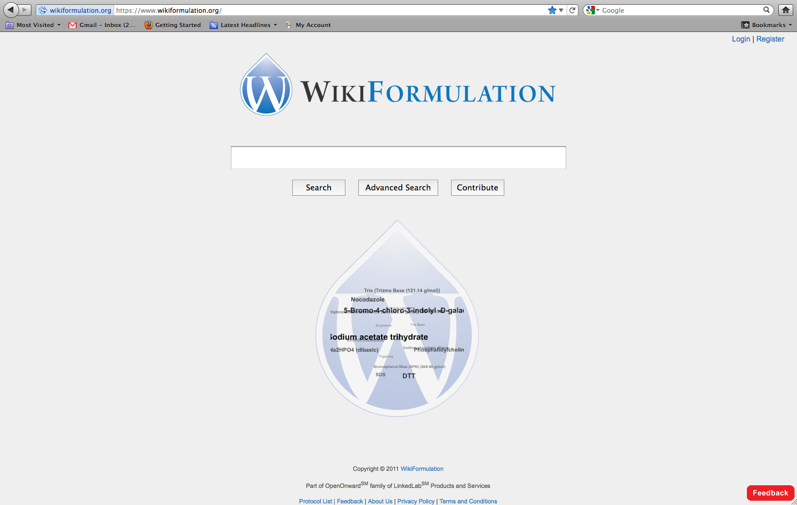

Slide 3
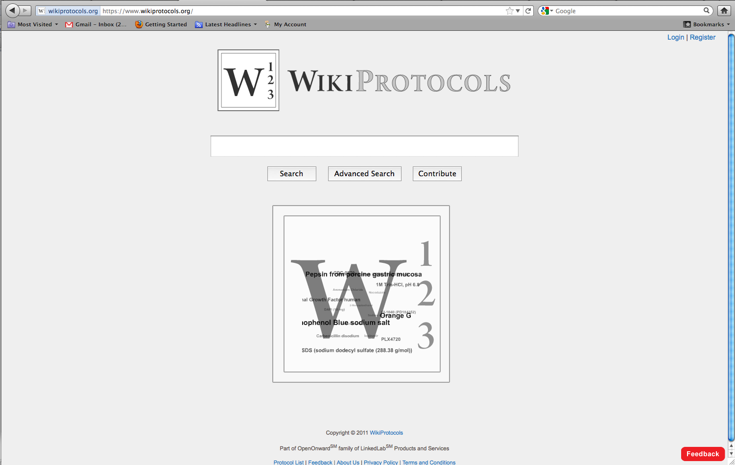

Slide 4
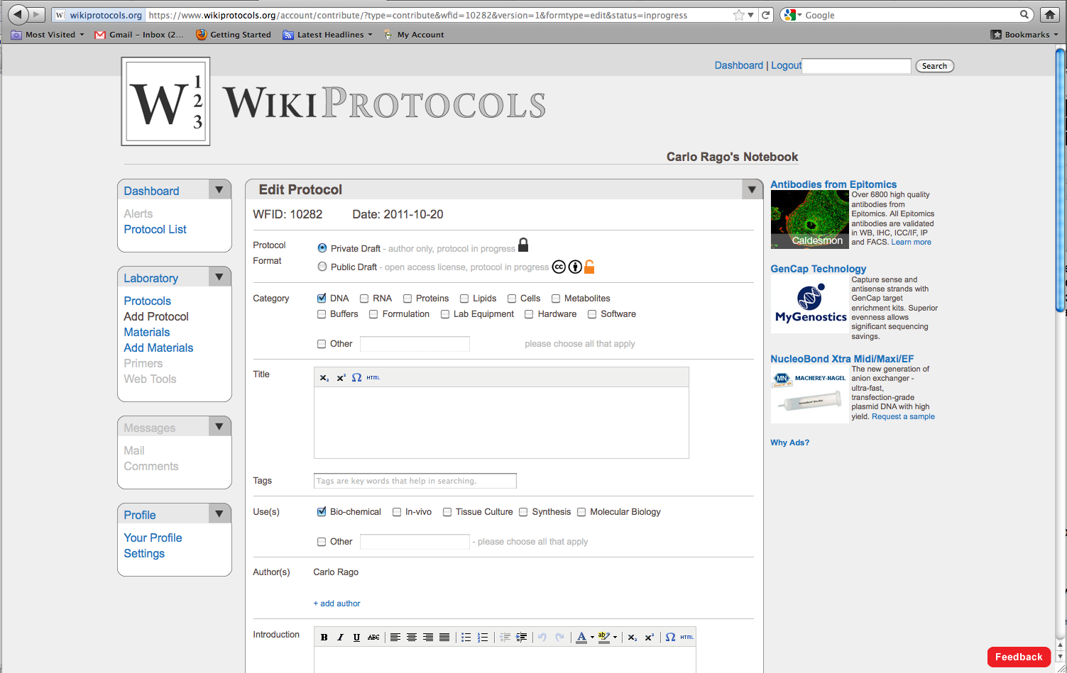

Slide 5
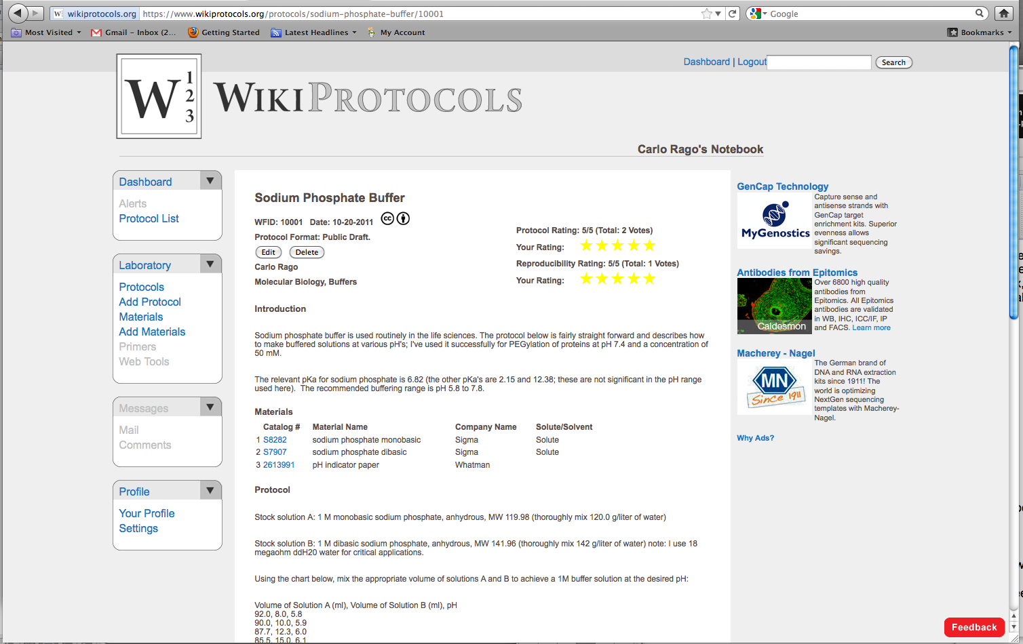

Slide 6
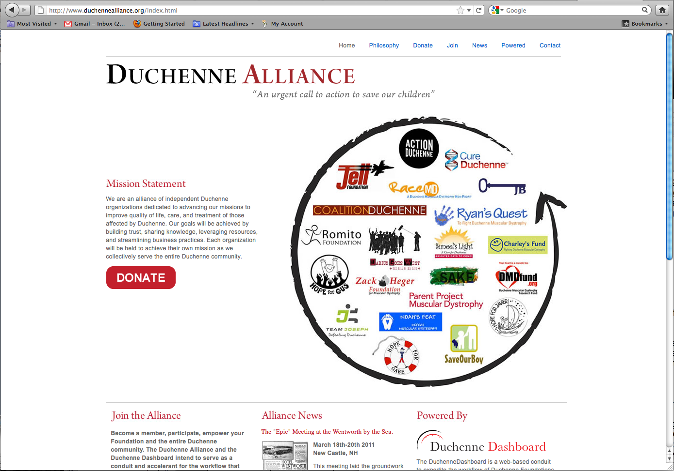

Slide 7
Information will be free or useless

Slide 8
Information will be more open or useless

