Slide 1
Open Source Drug Discovery
Matthew Todd, The University of Sydney
Open Science Summit, Mountain View/Sydney, Sometime October 2011
matthew.todd@sydney.edu.au
mattoddchem
MatToddChemistry
http://intermolecular.wordpress.com/

Slide 2
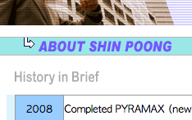
2/20
Praziquantel
Africa is Desperate for Praziquantel, Lancet 2010, 376, 496-498
http://www3.imperial.ac.uk/schisto; http://bit.ly/9azFHv

Slide 3
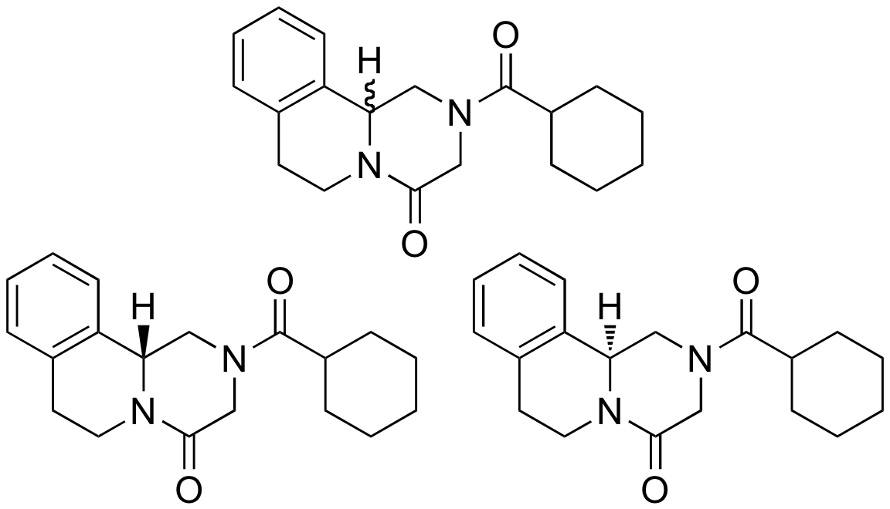
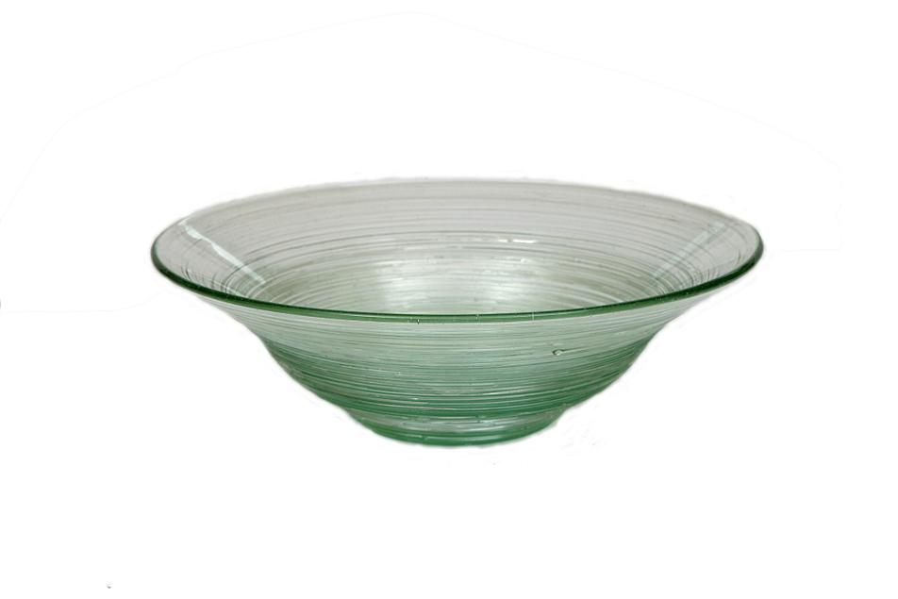
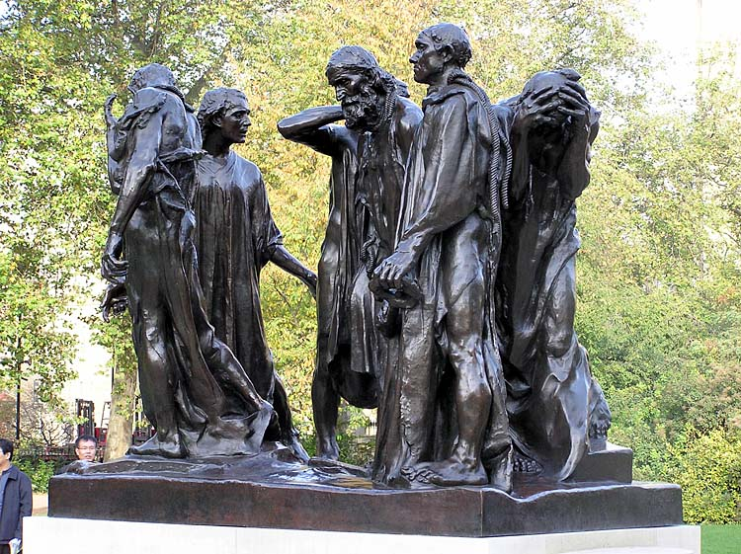
3/20
Enantiopure PZQ for a low, low price
GOT (10 ¢ g⁻¹)
NEED
BAD/BITTER
http://bit.ly/913iAm; http://bit.ly/KRdIZ; http://bit.ly/cJF1BW

Slide 4
4/20
Intractable Problem?
Breaking Point for Academia/Industry
Required Usefulness
Effectiveness of Solution
(“ee” in Chemical Terms)
Resources
(Person-years)
When you have a tough problem – ASK SOMEONE!

Slide 5
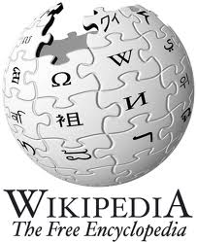
5/20
Open Source

Slide 6
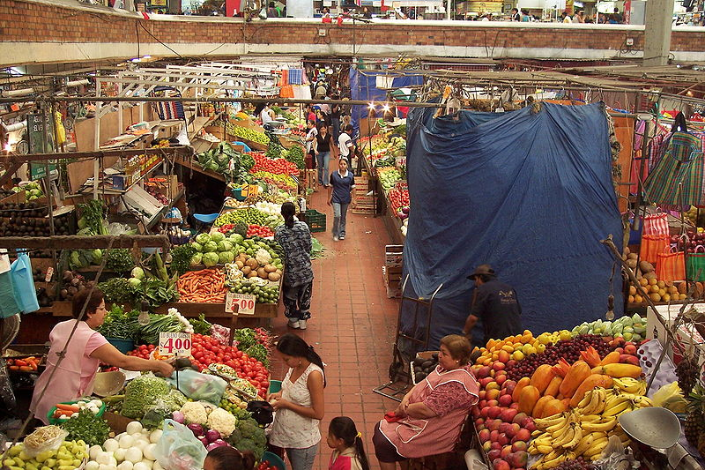
6/20
How we do things
http://bit.ly/9Pv119; http://bit.ly/9VTpqj

Slide 7
7/20
Ways of Doing Science

Slide 8
8/20
The Open Cycle
Problem
Pruning
Kernel
Detail
Holes
Community

Slide 9
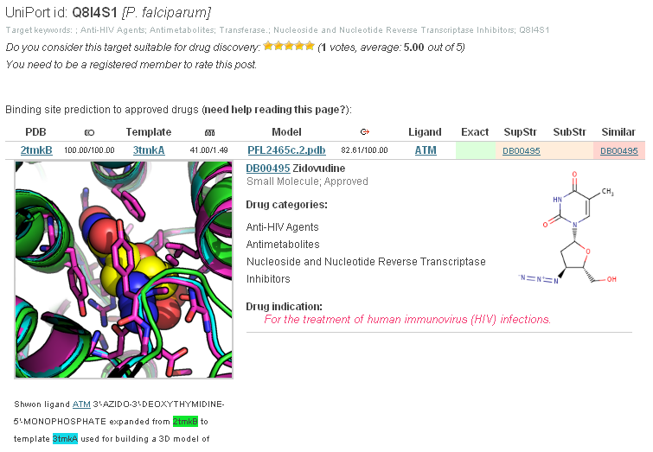
9/20
Sharing Data is Step 1
tropicaldisease.org
Nature Biotech. 2009, 27, 320-321.
Wall Street Journal
May 26th 2010

Slide 10
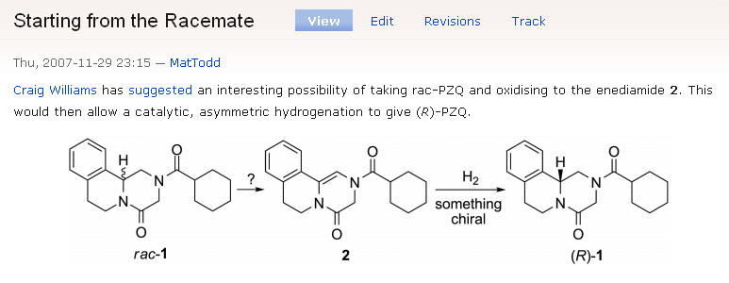
10/20
The Synaptic Leap

Slide 11
11/20
Funding

Slide 12
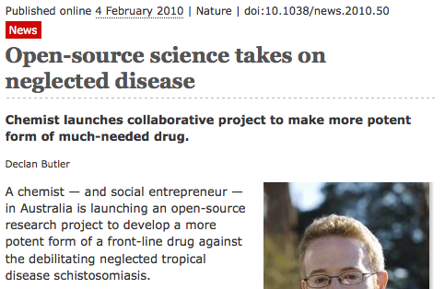
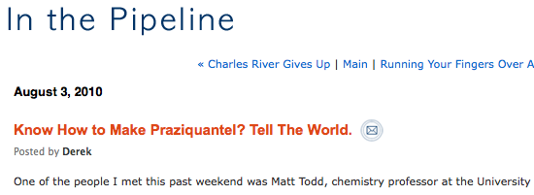
12/20
Publicity

Slide 13
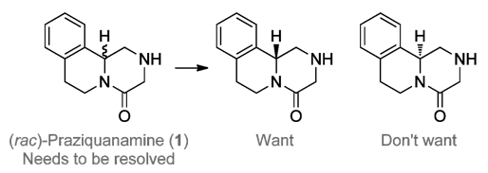
13/20
Companies? Seriously?
http://www.syncom.nl/hr/index.html; http://www.solvay.com/; http://www.intervet.com/; http://www.almacgroup.com/

Slide 14
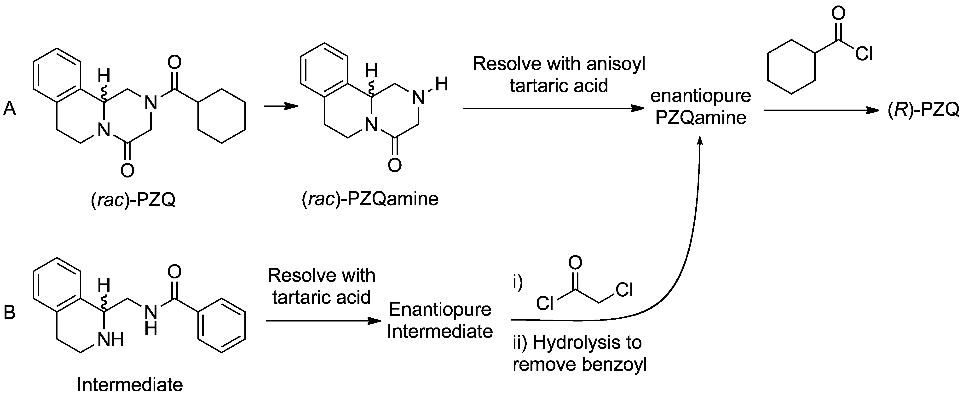
14/20
Current Solution
Details of Route: PLoS NTD 2011, 5(9): e1260
Full Description of Project: Nature Chemistry 2011, 3, 745-748

Slide 15
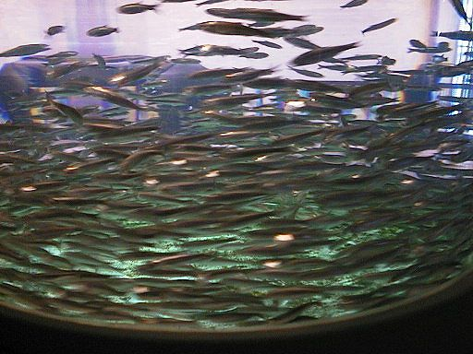
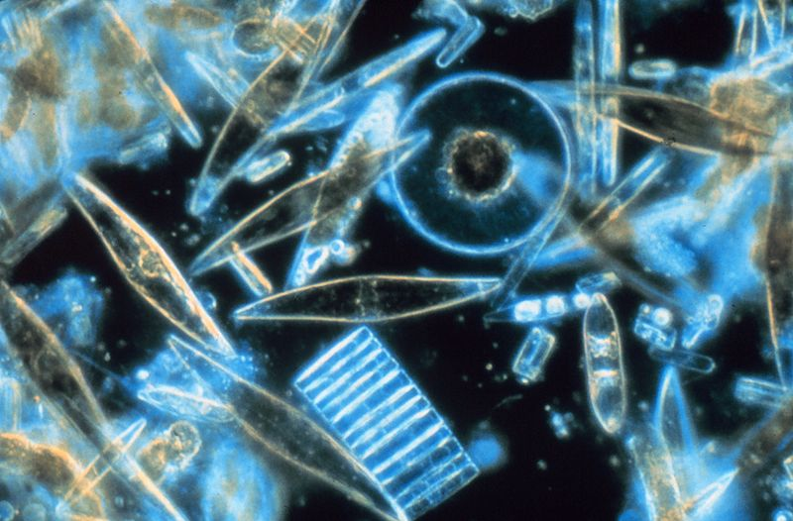
15/20
Advantages
http://bit.ly/dtkwf0, http://bit.ly/aqHWtV, http://bit.ly/bJNZ8N, http://bit.ly/8TrvZ4

Slide 16
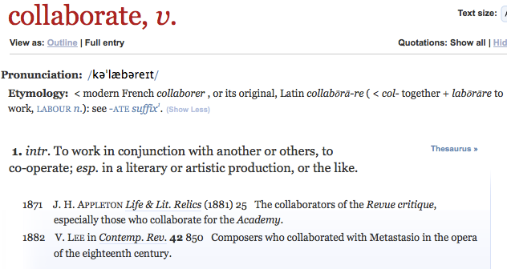
16/20
Diverse Inputs

Slide 17
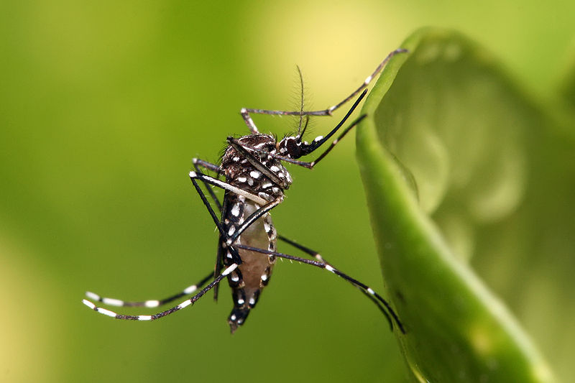
17/20
Open Source Drug Discovery?

Slide 18
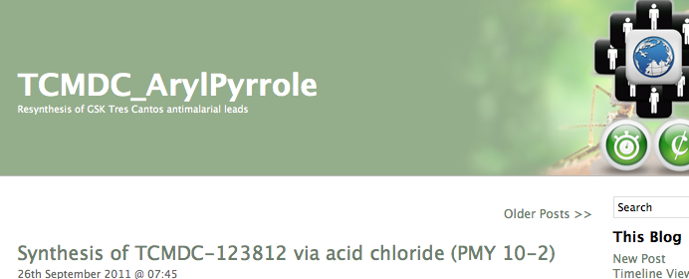
18/20
Start With Great Leads
ACS Med. Chem. Lett. 2011
10.1021/ml200135p

Slide 19
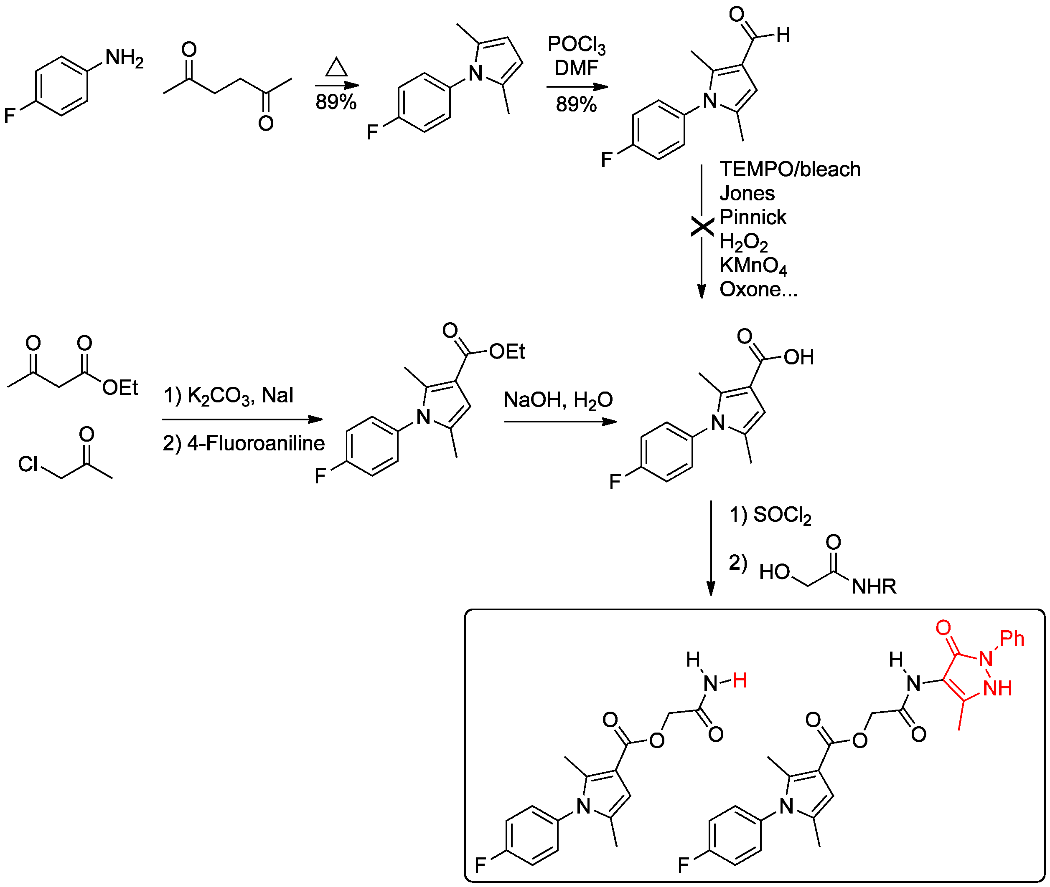
Resynthesis then Campaign
19/20

Slide 20
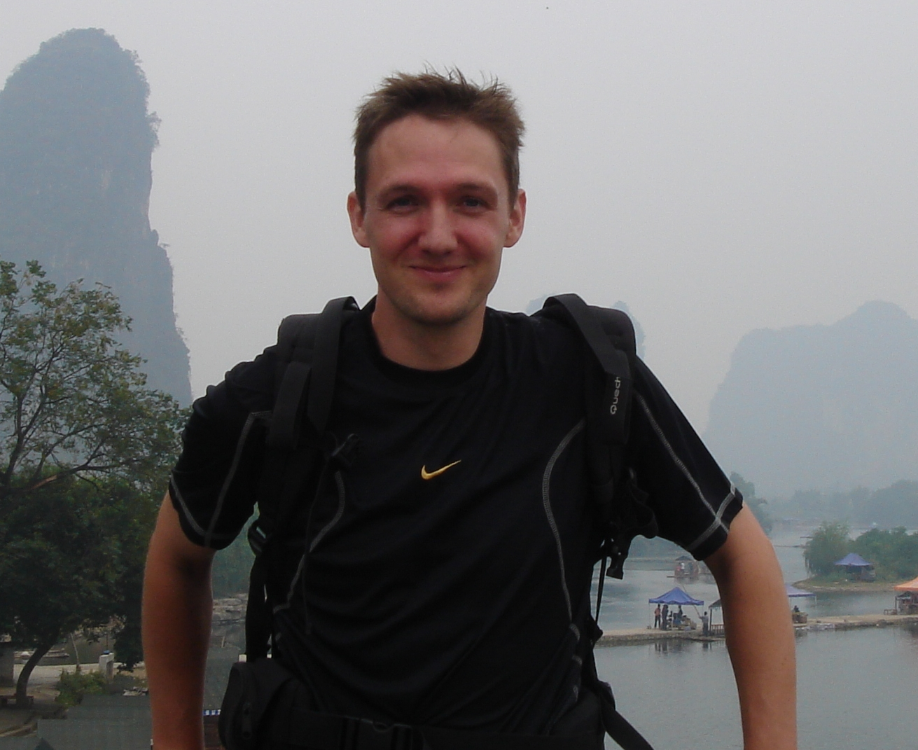
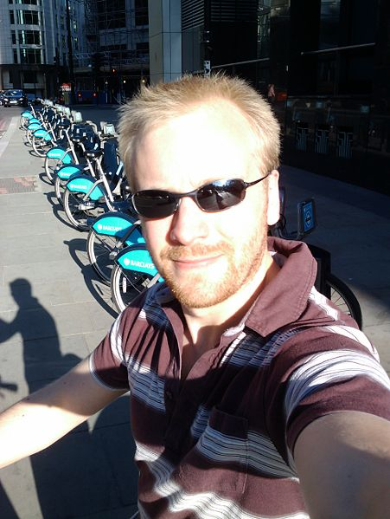
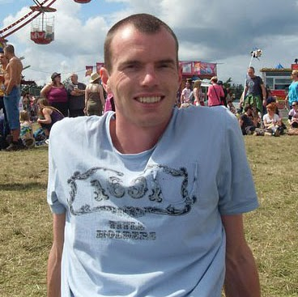
20/20
Michael Woelfe, Paul Ylioja, Murray Robertson (USyd), Piero Olliaro (WHO/TDR), Jean-Paul Seerden (Syncom) and many other online collaborators
Tim Wells, Paul Willis and Jeremy Burrows (MMV)
Jeremy Frey and team (Uni Southampton)

