Slide 1
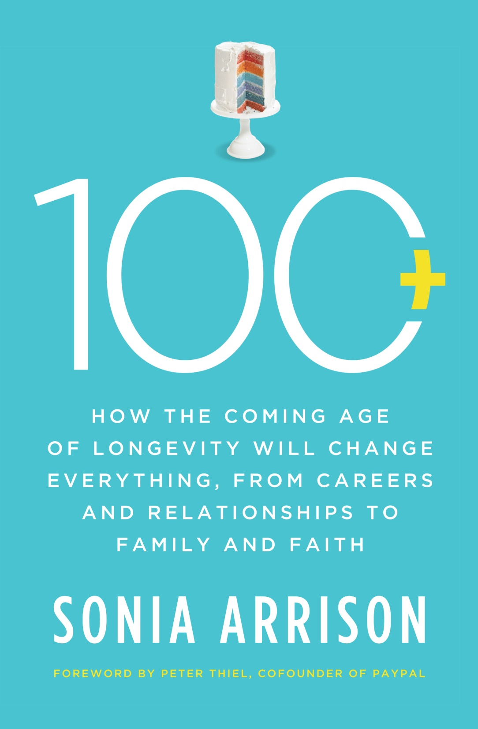

Slide 2
From 18 years to 80 years

Slide 3
Biology Has Become An Engineering Project

Slide 4
Richer
Gains in life expectancy over the last century (30 years) are worth over $1.2 million per person to the current population
From 1970 to 2000, gains in life expectancy (5 years)added about $3.2 trillion per year to national wealth
Source: Kevin Murphy (U Chicago) and Robert Topel (National Bureau of Economic Research), 2006.

Slide 5
More Education
Longer lives are correlated with expanding education.

Slide 6
I do -- later
The age at first marriage has been on the rise for decades, and today the median age is 28 years for men and 26 years for women, up from 23 and 20 years, respectively, in 1950.

Slide 7
Era of the 70 Yr old Mom
In 2008, Rajo Devi gave birth to a baby girl in India. She was 70 years old.
The average age of first-time mothers in America has steadily increased over the last four decades, from 21.4 to 25 years. More importantly, the proportion of first births to women aged 35 years and older increased by nearly eight-fold from 1970 to 2006.

Slide 8
Religion in a Longer-Lived World

Slide 9
Population & Environment

Slide 10
Where we are – the good…
Top 10 Countries - Life Expectancy
Top 10 Countries | 2010 Life Expectancy Estimate
Monaco | 89.78
Macau | 84.38
San Marino | 82.95
Andorra | 82.36
Japan | 82.17
Singapore | 82.06
Hong Kong | 81.96
Australia | 81.72
Canada | 81.29
France | 81.09

Slide 11
Where we are – the bad…
Bottom 10 Countries …
Bottom 10 Countries | 2010 Life Expectancy Estimate
South Africa | 49.20
Guinea-Bissau | 48.30
Chad | 47.99
Swaziland | 47.97
Zimbabwe | 47.55
Nigeria | 47.24
Afghanistan | 44.65
Mozambique | 41.37
Zambia | 38.86
Angola | 38.48

Slide 12
Access & Distribution of Technology
An Accelerating Trend?
It took…
46 years for a quarter of the US population to get electricity
35 years for the telephone
16 years for the personal computer
13 years for the cell phone
7 years for Internet access

Slide 13
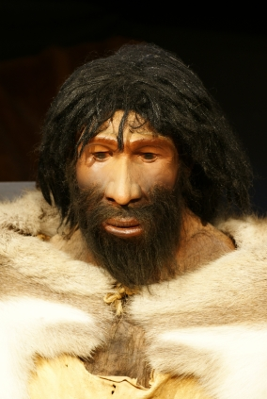
Natural ?

