Slide 1
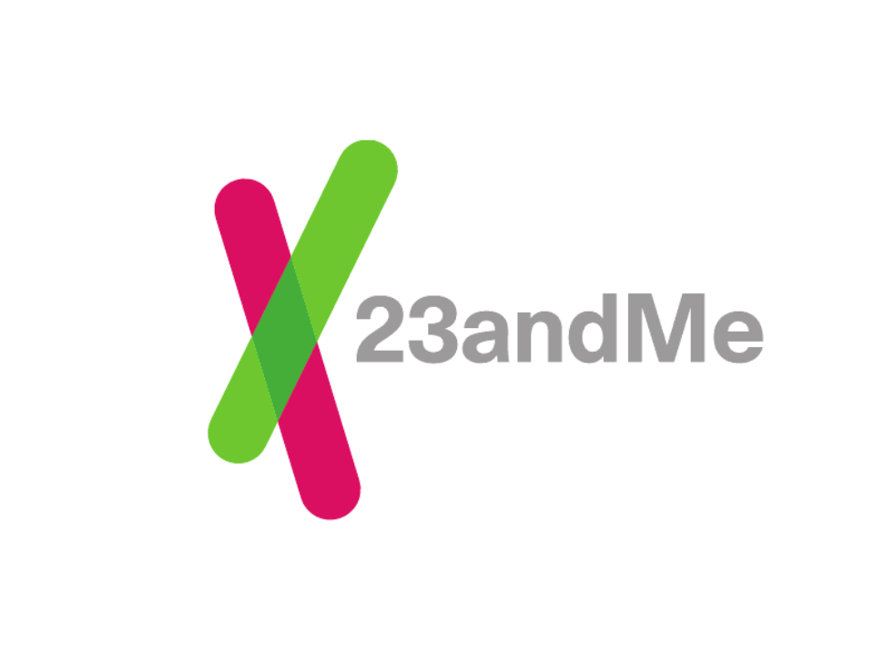
October, 2011

Slide 2
23andMe is a platform for:
Empowering individuals with personal genetic information
Engaging individuals in research
Accelerating discoveries
Copyright © 2008-2011 23andMe, Inc. All rights reserved.

Slide 3
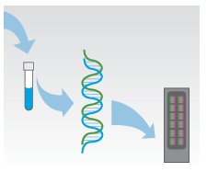
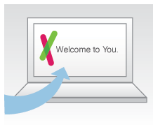
What is 23andMe?
From saliva to data
Order a kit via
our web site.
Log in and explore
your genetic data.
CLIA lab extracts DNA from your sample and analyzes it at ~1M locations.
Copyright © 2008-2011 23andMe, Inc. All rights reserved.

Slide 4
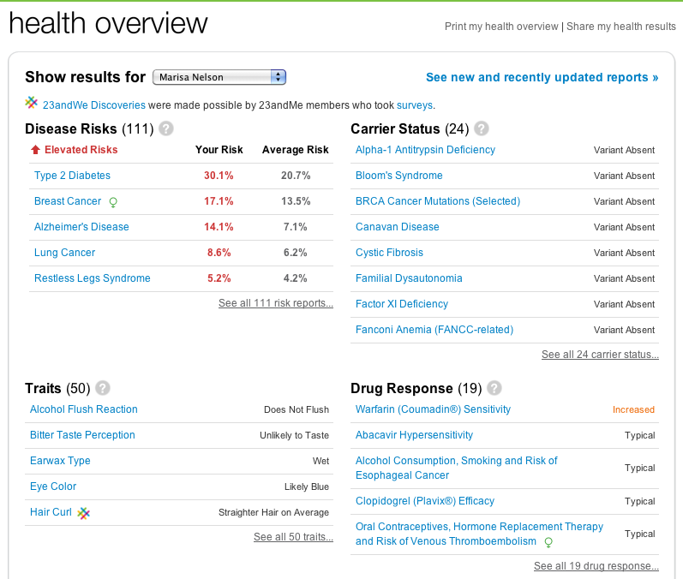
Copyright © 2008-2011 23andMe, Inc. All rights reserved.

Slide 5
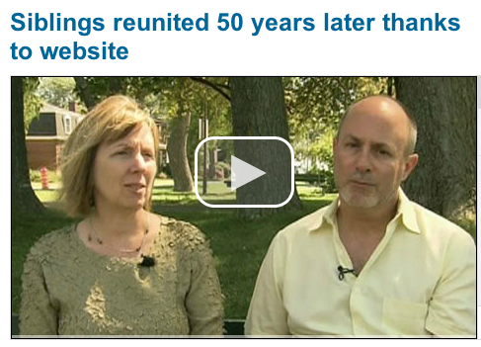
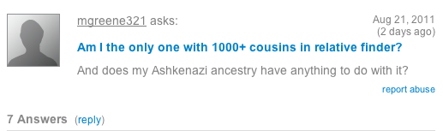
Relatives Found!
Copyright © 2008-2011 23andMe, Inc. All rights reserved.

Slide 6
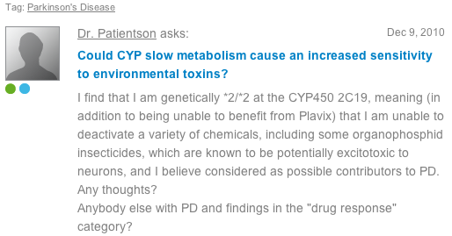
Social Networking Tools
Copyright © 2008-2011 23andMe, Inc. All rights reserved.

Slide 7
23andMe is a platform for:
Empowering individuals with personal genetic information
Engaging individuals in research
Accelerating discoveries
Copyright © 2008-2011 23andMe, Inc. All rights reserved.

Slide 8
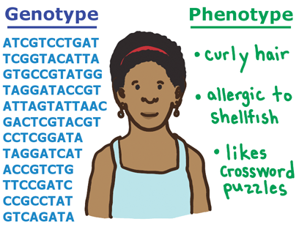
We Look at the Whole Picture
Copyright © 2008-2011 23andMe, Inc. All rights reserved.

Slide 9
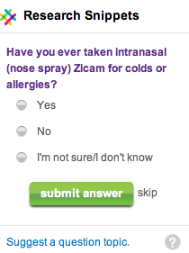
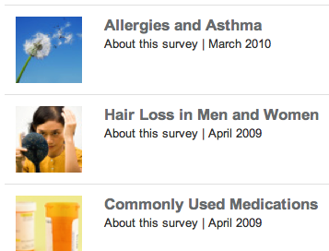
Multiple Methods for
Phenotype Data Collection
Research Snippets
60+ Surveys
Health Intake
Copyright © 2008-2011 23andMe, Inc. All rights reserved.

Slide 10
Health Intake Form
Copyright © 2008-2011 23andMe, Inc. All rights reserved.

Slide 11
23andMe is a platform for:
Empowering individuals with personal genetic information
Engaging individuals in research
Accelerating discoveries
Copyright © 2008-2011 23andMe, Inc. All rights reserved.

Slide 12
The Parkinson’s Community: From Data to Discoveries
http://www.plosgenetics.org/article/info:doi/10.1371/journal.pgen.1002141
Copyright © 2008-2011 23andMe, Inc. All rights reserved.

Slide 13
State of the Database
Copyright © 2008-2011 23andMe, Inc. All rights reserved.

Slide 14
Opportunities for Innovators
Targeted Phenotype vs Control Analysis
Longitudinal Studies
Patient-Engagement Registries & Research Communities
Clinical Trial Recruiting
Copyright © 2008-2011 23andMe, Inc. All rights reserved.

