Slide 1
Making Product Sourcing a Community Affair
Alex Hodgson
Notes:
.

Slide 2
Notes:
Grew up working in restaurants where the quality of your ingredients was paramount
I worked for Aled Edwards, at the Structural Genomics Consortium for 5 years and saw that at a bench level, that was the same.

Slide 3
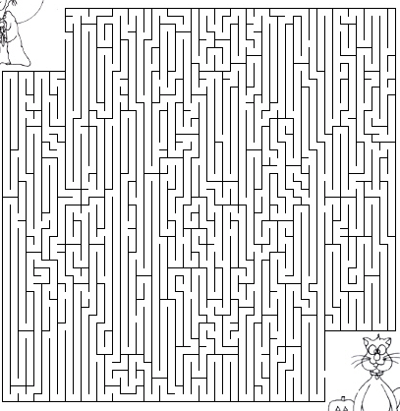
Current Reality
Researcher
Sift through Google Results
Search Site to Site
Sift through Publications
Ask Colleagues
Buy Multiple
Products
Cold Call Other Labs
Guess
Product

Slide 4
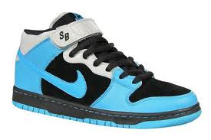

Slide 5
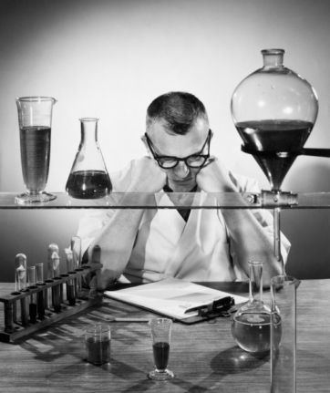
Serious Consequences
HUGE RISKS
Failed Experiments
Wasted Resources
Lost Time
Lose Grant
Rejected Publications
Lose Credibility
THE RISKS
Lose Credibility
Notes:
Life Sciences market is filled with millions of products, thousands of suppliers and no good way to evaluate which product sis best.
Making the wrong choice has huge consequences. It leads to wasted experiments, time and lost opportunities. Competitive advantage vanished. Grants can be lost. Credibility can be compromised.
With all the advances we’ve seen in the online world this is something can be solved. This is something that needs ot be solved.
That’s why we created BioHub

Slide 6
Going to Extremes for Quality
Michael J. Fox Foundation spend 10m to identify and eventually commission development of 2 quality reagents for LRK2, for furthering Parkinson’s Research
Harvard study showed when looking at Cancer related targets – commercially available reagents essential for furthering research failed over 50% of time – products were of insufficient quality.
According to HUPO (Human Proteome Organization), many commercial reagents fail to include even basic information required for proper usage.
Notes:
The problem is becoming os severe that even disease foundations are stepping in… LRK2 example
Harv

Slide 7
Plenty of Consumer Tools
Notes:
No one can deny that the
internet has brought about
great changes in the way
we evaluate products and services.
As you look at the companies shown here, these are just a fraction of the number of services to as consumers today that help us make better purchasing decisions.
Whether we are looking to book travel, choose a restaurant pick a movie, evaluate a new gadget
These services are becoming part of our everyday lives.

Slide 8
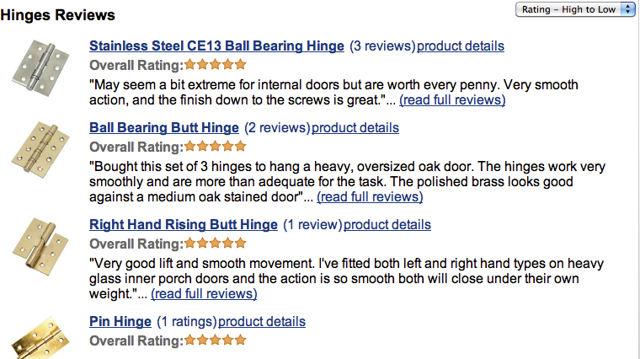
Even for Door Hinges…

Slide 9
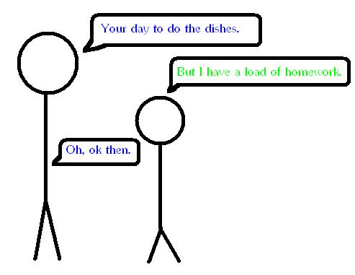
Bridging the gap
?
Notes:
2.50-3 That’s why we created BioHub.

Slide 10
So how did we get here???

Slide 11
How did this happen?
100’s of manufacturers, 1000’s of distributors.
The growth of cross-licensing
No governing body regulating quality
No centralized resource
Poor communication between users
Poor feedback mechanism for companies

Slide 12
Building a better way…

Slide 13
Hybrid Model
Community Resource
Revenue Generation
Comprehensive
Easy to Use
Independent
Open Access
Sustainable
Products Ranked by Quality
ADs
Notes:
Building the community part was easy, but though faced with how to fund the project, you are faced with the option of grant or revenue model, and well, to be honest there are so many incredible research efforts that rely on every

Slide 14
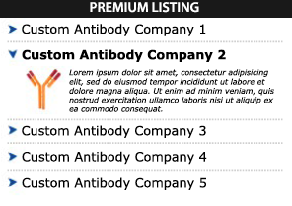
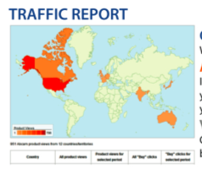
Hybrid Model
Community Resource
Revenue Generation
Comprehensive
Easy to Use
Independent
Open Access
Sustainable
Products Ranked by Quality
Premium Listings
Directory
Listings
Market Research
Analytics

Slide 15
Generating Content
Publications
Reviews
Products
Spread the Word
Products
Quality Control Data
Promotion
Put themselves out there
Notes:
2.50-3 That’s why we created BioHub.

Slide 16
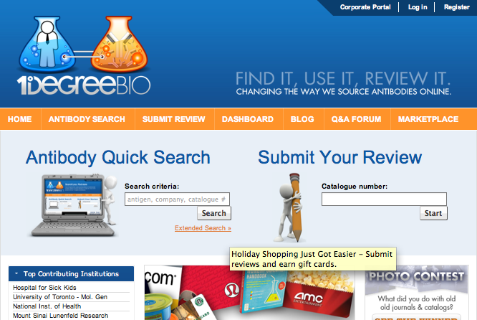
Community driven growth
Site Content
37,500
605,000
156
993
168,000
1583
Users
Products
Suppliers
Distributors
Product Citations
Reviews
Contribution Rate: 5.84%

Slide 17
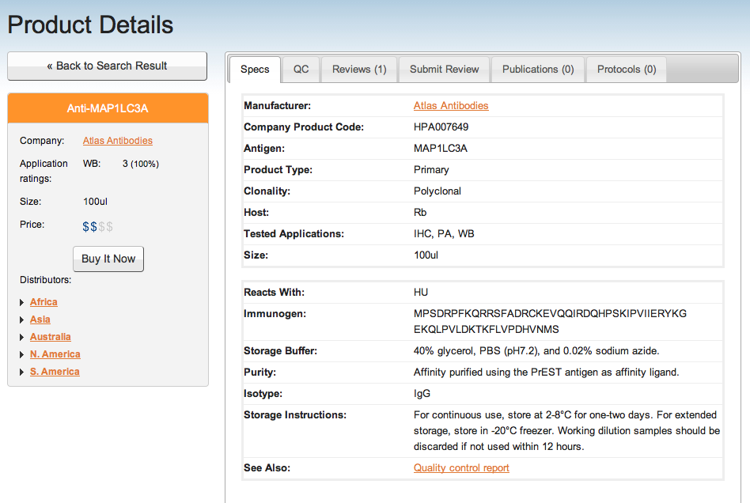
Product Listings
(6)
(1)

Slide 18
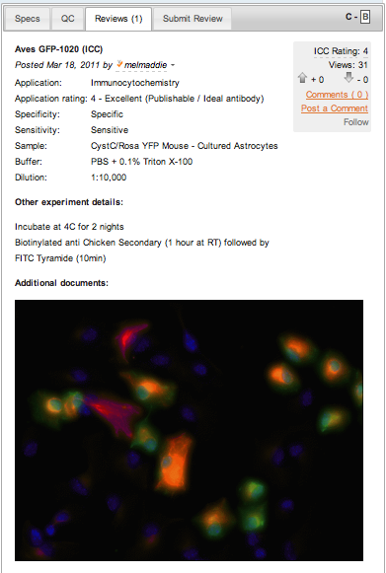
Reviews
1573 Reviews

Slide 19
What I learned…

Slide 20
Advice/Lessons Learned
Don’t let anyone tell you that its impossible.
Don’t build your business model in a vacuum.
You don’t look the same as you did when you were 3, 14, 29….. Neither will your business model.
Start-up “War wounds” build character and create a better product.
The right investment partners are out there.
Notes:
Right partners. Gave close to 100 pitches. Either we were too sciency for the tech guys. Too techy for the life scientists.

Slide 21
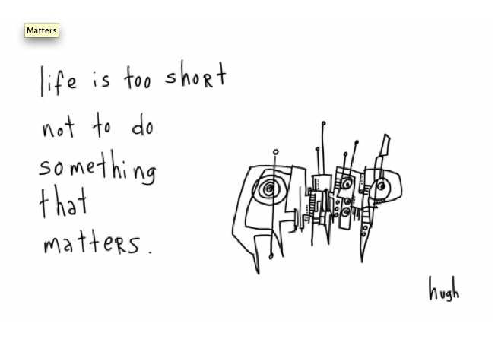

Slide 22
1DegreeBio Team

Slide 23
Thanks
For More Information Contact
Alexandra Hodgson
Tel: 647.981.2461
Email: alex@1degreebio.org
URL: www1degreebio.org
@1DegreeBio

